Slide 1
File navigation and IO
Python for neuroscience
08/05/2024

Slide 2
File navigation
Lost in the sauc- eh in the files

Slide 3
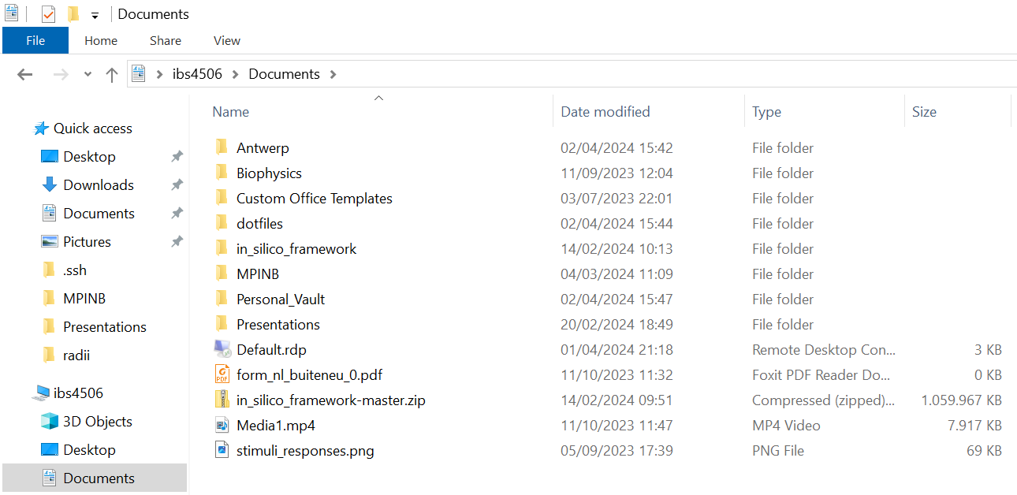
What you already know

Slide 4
How to do this in Python: the os package
os.dirname(“.”)
os.getcwd()
os.listdir(“.”)

Slide 5
Filetree
Moving “up” and “down”
This directory: .
The directory above: ..
C:\ is: .\\..\\..
C:\ is also:
os.dirname( os.dirname( os.dirname(‘MPINB’) ))
C:\
Users
Program files
meulemeester
Desktop
Documents
Downloads
Antwerp
MPINB
…
Temp
Windows

Slide 6
File IO
Fayalo

Slide 7
When to use “direct” IO
Gathering data in real-time
No fixed file format

Slide 8
Warnings before we start
Concurrency
Are multiple processes trying to write to the same file?
This may lead to corrupted files. All your hard work gone :(
Buffering
Did you close your file?
How often are you trying to open/close a file per second? Your hard drive may get angry at you if you’re doing it 1000 times per second.
Permissions
Can Python access the location of the file you’re trying to write to?
Does Python have write access?

Slide 9
IO: Input/Output
# Writing data
filename = “./my_file.txt”
opened_file = open(filename, “w”)
opened_file.write(“hi mom!”)
opened_file.close()
# Reading data
opened_file = open(filename, “r”)
my_text = opened_file.read()
print(my_text)
> hi mom!

Slide 10
IO: Input/Output
# Writing data
filename = “./my_file.txt”
opened_file = open(filename, “w”)
opened_file.write(“hi mom!”)
opened_file.close() <-------- Dangerous!
# Reading data
opened_file = open(filename, “r”)
my_text = opened_file.read()
print(my_text)
> hi mom!

Slide 11
IO: Input/Output
# Writing data
filename = “./my_file.txt”
with open(filename, “w”) as opened_file: <---- Much better :)
opened_file.write(“hi mom!”)
# Reading data
with open(filename, “r”) as opened_file:
my_text = opened_file.read()
print(my_text)
>>> hi mom!

Slide 12
Built-in file IO
Sometimes, Python packages have built-in options for file IO
Numpy: save() load() array.to_file() …
Pandas: read_csv() read_excel() to_csv() to_excel()

Slide 13
File & directory management
# Creating directory
os.mkdirs(“.\my_cool_directory\my_cool_sub_directory”)
# Deleting a directory
shutil.rmtree(“.\my_cool_directory”)
# Deleting your entire computer
shutil.rmtree(“C:\”)

Slide 14
Good practices
# Sanity checks
os.path.exists(“my_cool_directory”)
# path separators
os.path.join(“my_cool_directory”, “my_cool_subdirectory”)
>>> “.\my_cool_directory\my_cool_subdirectory” <-- Windows
>>> “./my_cool_directory/my_cool_subdirectory” <-- The rest

Slide 15
Happy coding!
Get them files IO’d

